Slide 1
Cost Concepts
APSC 221 – Week 1
Summer 2024

Slide 2
To begin the journey in engineering economics, we must first touch upon the most basic of economic principles:
Costs
&
Revenues

Slide 3
Terminology
Fixed Costs:
Unaffected by changes in activity level over the anticipated, feasible range of operations
Insurance, Licenses, Administrative salary
Variable Costs:
Vary with the quantity of output or other variation in activity level of the operation
Labour costs, materials
Incremental Costs/Revenues:
Additional cost/revenue from increasing the output of the system
Overtime shift

Slide 4
Terminology
Direct Costs:
Costs that can be reasonably measured and allocated to specific work/output
Production labour, production materials
Indirect Costs (burden/overhead):
Costs that are difficult to allocate to specific work
Taxes, utilities

Slide 5
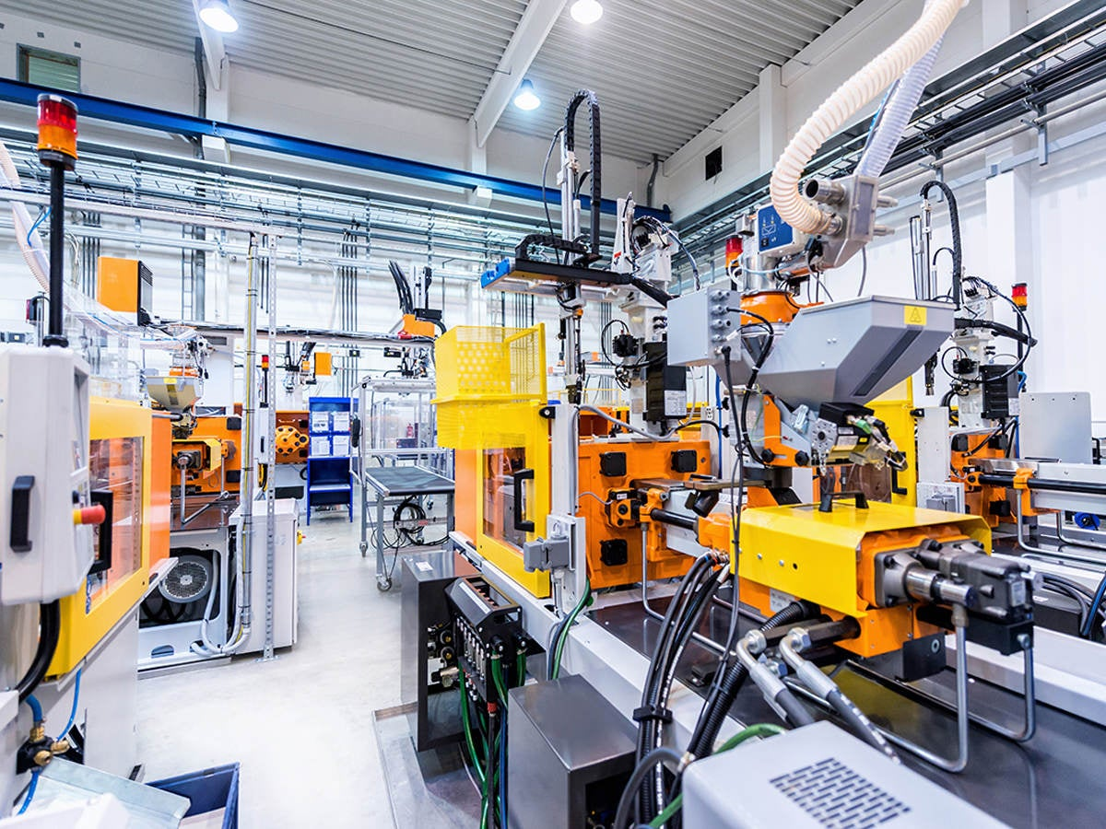
Terminology - Accounting
Cash Costs:
Costs paid in cash and have associated cash flow
Book Costs:
Cost not involving a cash transaction and used for accounting purposes
Example – Purchase of production line machinery

Slide 6
Terminology - Replacement & Uncertainty
Life Cycle Cost:
Sum of all costs related to something (ie, buy, maintain, sell)
Sunk Cost:
Costs from the past that have no relevance to a future decision
Opportunity Cost:
Costs incurred due to directing limited resources to a specific course of action
Example – Selling production line machinery

Slide 7
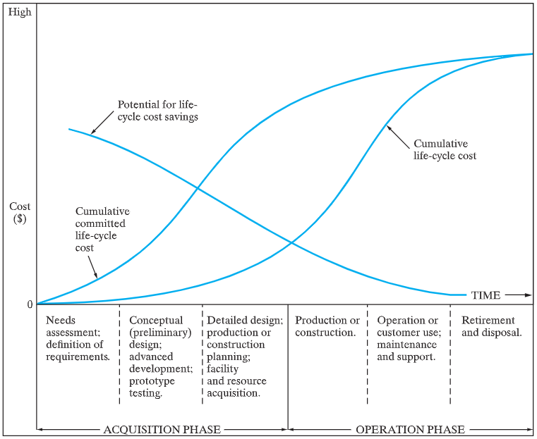
Life Cycle Phases and Costs
What can we learn from this life-cycle cost curve?

Slide 8
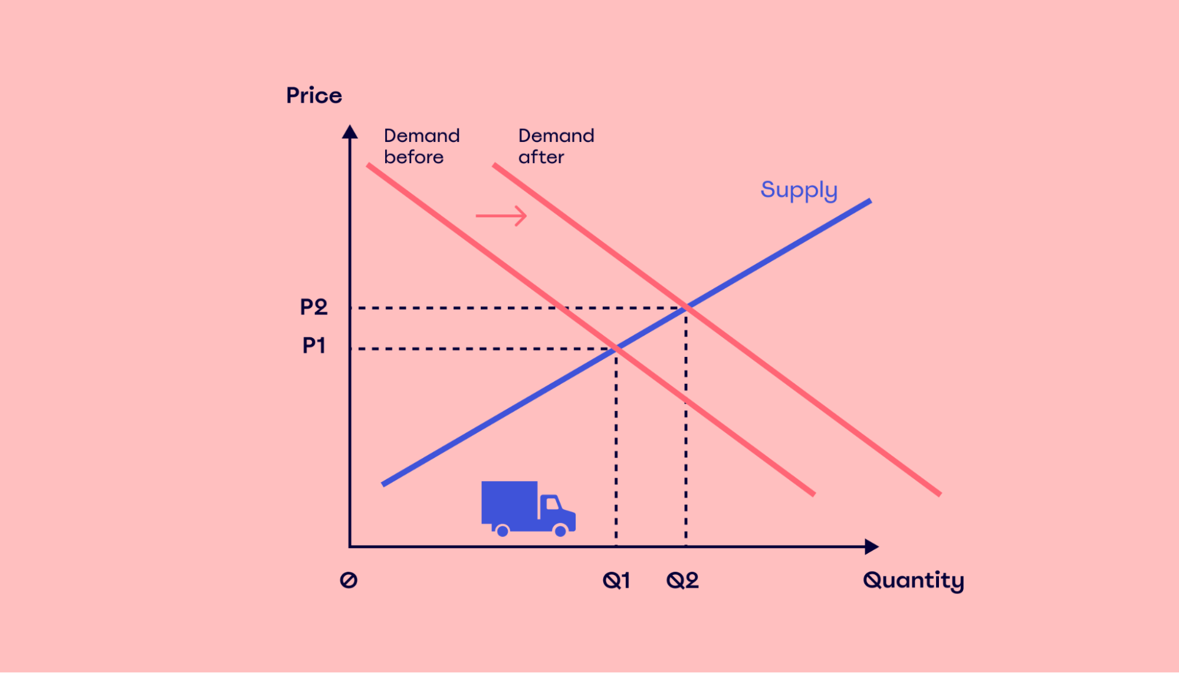
Price-Demand & Supply-Demand Relationship

Slide 9
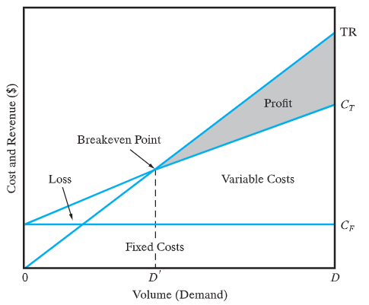
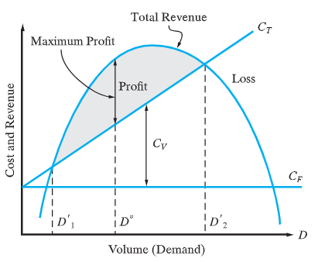
What is the ultimate business goal?

